Slide 1


DATA STRUCTURE AND ALGORYTHMS -SELF PACED
NOTE:
To change images on this slide, select a picture and delete it. Then click the Insert Picture icon
in the placeholder to insert your own image.

Slide 2

DATA STRUCTURE AND ALGORITHMS -SELF PACED
GeeksforGeeks
Submitted in partial fulfilment of the requirements for the award of degree of
B.Tech(CSE)
Name of Student: Rohit Kumar
Registration Number: 12104675
LOVELY PROFESSIONAL UNIVERSITY
PHAGWARA, PUNJAB

Slide 3
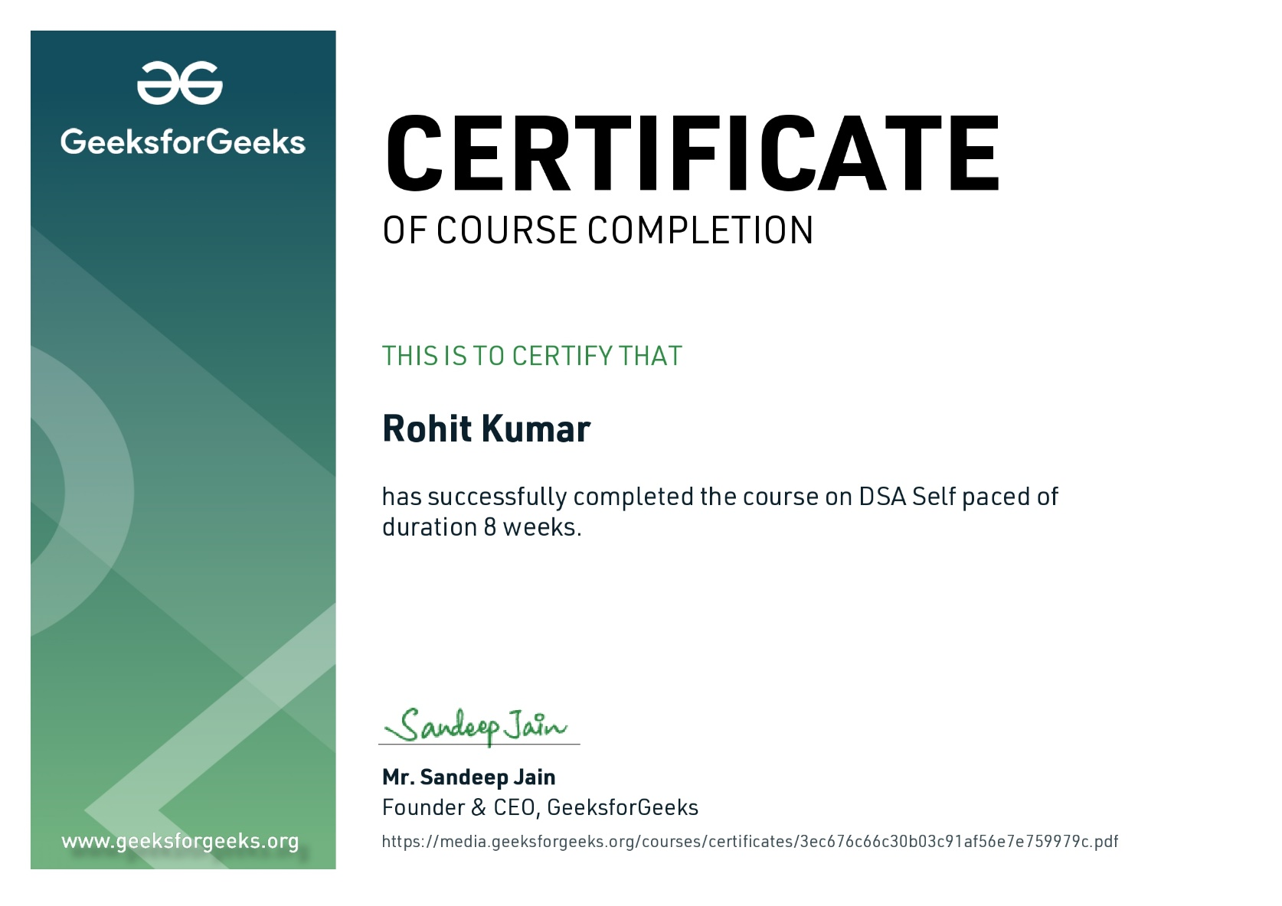
CERTIFICATE

Slide 4
Introduction
I'm really excited to share that what I learned in this course. first we will know what is Data Structure so I would say in simple way Data structures allow us to store and organize the data, while algorithms allow us to process that data in a meaningful way. Think of sequences of numbers, or tables of data these are both well-defined data structures. I learned so much about the fundamental concepts of data structures and algorithms, one thing I like about this course it is self paced so you can learn and whenever you want to revise it’s life time accessed and I'm confident that this knowledge will be essential for my future career in computer science.

Slide 5
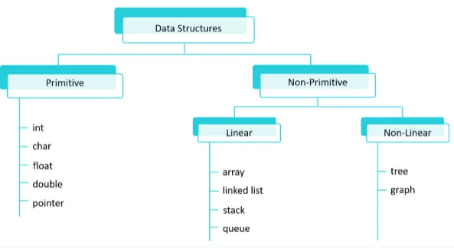
TYPES OF DATA STRUCTURE
Primitive
Int
Float
Char
Double
Non Primitive
Linear
Array
Searching
Sorting
Linked List
Stack
Queue
Non Linear
Tree
Graph

Slide 6
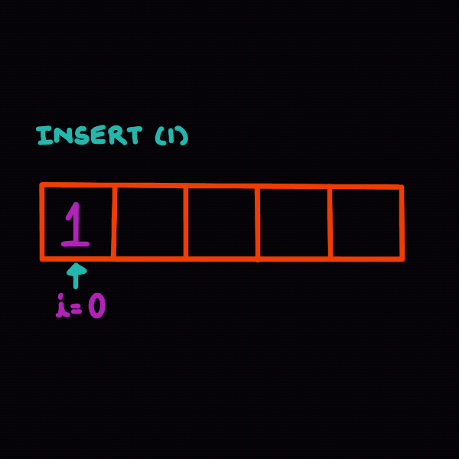
ARRAY
An array is a fundamental data structure that allows you to store and manage a collection of elements of the same data type.
The elements of an array can be of any data type, such as integers, strings, or objects.
The size of an array is fixed, and it cannot be changed once it is created.
The elements of an array are stored in contiguous memory locations, which means that they are stored next to each other in memory.
Arrays can be accessed by their index, which is an integer that specifies the position of the element in the array.
Arrays can be sorted and searched, which means that the elements of the array can be arranged in order or searched for a specific element.

Slide 7
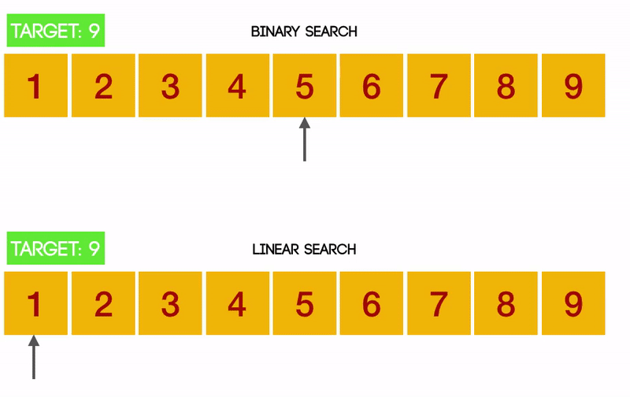
SEARCHING AND SHORTING
Searching
Searching is the process of finding a specific item in a collection of data.
The most common searching algorithms are linear search and binary search.
Linear search is a simple algorithm that checks each item in the collection sequentially until the desired item is found.
Binary search is a more efficient algorithm that divides the collection in half at each step and only searches the half that contains the desired item.
Sorting
Sorting is the process of organizing a collection of data in a specific order.
The most common sorting algorithms are bubble sort, selection sort, insertion sort, merge sort, and quick sort.
Bubble sort repeatedly compares adjacent items and swaps them if they are in the wrong order.
Selection sort repeatedly finds the smallest item in the collection and swaps it with the first item.
Insertion sort repeatedly inserts an item into the correct position in the sorted part of the collection.
Merge sort divides the collection into two halves and sorts each half recursively.

Slide 8
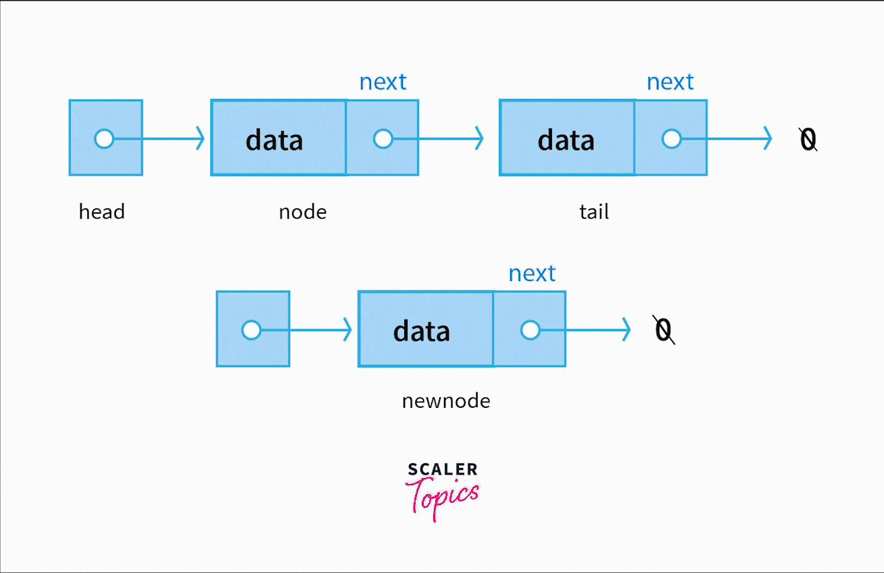
LINKED LIST
A linked list is a linear data structure that consists of a sequence of elements
Each of which contains a reference (or link) to the next element in the sequence.
Linked lists do not have a fixed size , like array and their elements, called nodes, are not stored in contiguous memory locations. Instead , they are connected through pointers , forming a chain-like structure.
Linked lists can be traversed in both forward and backward directions.
Linked lists can be sorted and searched, but they are not as efficient as arrays for these operations.
The size of a linked list is not fixed, and it can grow or shrink as needed.

Slide 9
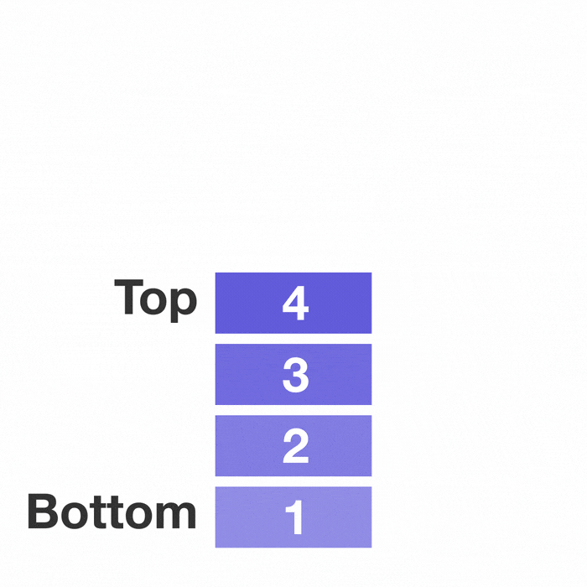
STACK
A stack is a linear data structure that follows the Last-In-First-Out (LIFO) principle.
Elements are added to the top of the stack through an operation called "push".
Elements are removed from the top through an operation called "pop".
Stacks are used in various real-world scenarios, including function call management in computer memory (the call stack), backtracking algorithms
Stacks are typically used for scenarios where the most recently added item should be processed first

Slide 10
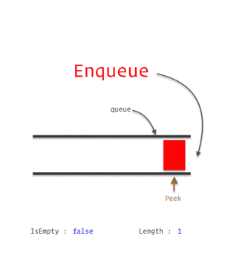
QUEUE
A queue is a linear data structure that follows the First-In-First-Out (FIFO) principle.
The elements of a queue are stored in a linear fashion, which means that they are stored one after the other in memory.
The elements of a queue can be of any data type, such as integers, strings, or objects.
They are efficient for storing and retrieving data in a first-in, first-out order.
Elements are added to the back of the queue through an operation called "enqueue."
Elements are removed from the front of the queue through an operation called "dequeue."

Slide 11
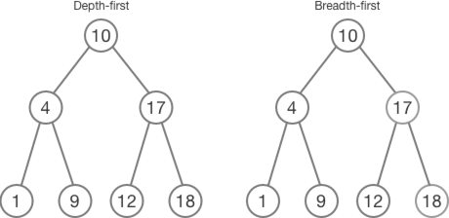
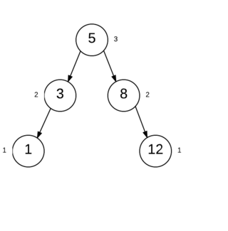
TREE
DFS
BFS
A tree is a data structure that consists of nodes connected by edges. The nodes are arranged in a hierarchical structure, with each node having zero or more child nodes.
The root node is the topmost node in the tree, and it has no parent node.
The leaf nodes are the nodes at the bottom of the tree, and they have no child nodes.
They can be used to solve a variety of problems, such as searching, sorting, and traversing data.
Binary trees: A binary tree is a tree in which each node has at most two child nodes. The child nodes are called the left child and the right child.
Binary search trees: A tree in which the values of the nodes are arranged in increasing order. This means that the value of each node is greater than the values of all of its left child nodes and less than the values of all of its right child nodes.
AVL trees: An AVL tree is a self-balancing binary search tree. This means that the tree is always kept in a balanced state.
AVL TREE

Slide 12
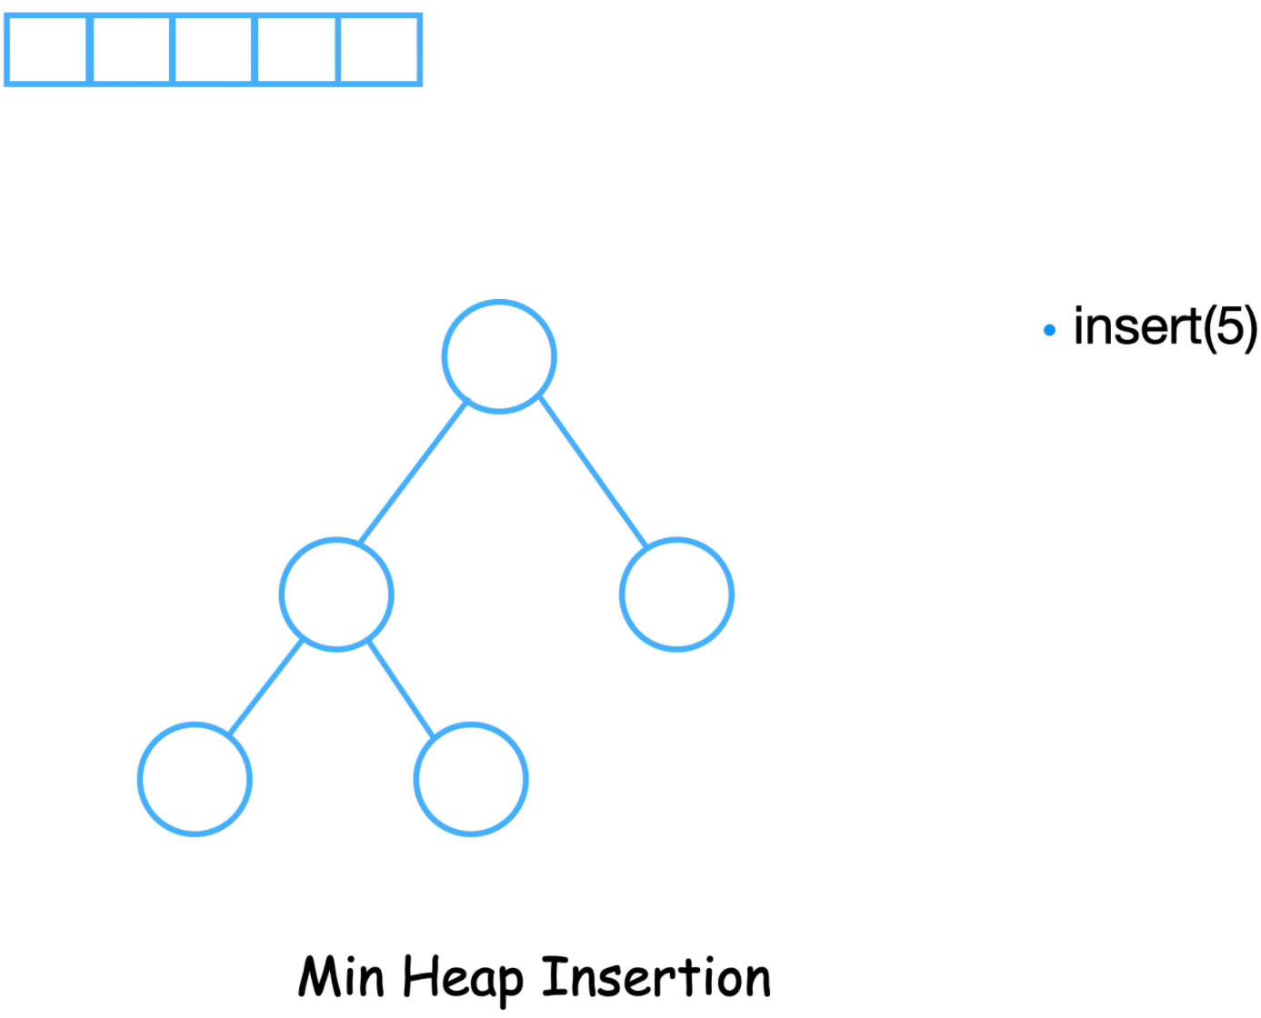
HEAP
A heap is a tree-based data structure in which the elements are stored in a specific order, such that the parent of any node is always smaller (in the case of a min heap) or larger (in the case of a max heap) than the node itself.
There are two main types of heaps: Mean Heap & Max Heap
Min heap: In a min heap, the smallest element is always at the root of the heap.
Max heap: In a max heap, the largest element is always at the root of the heap.
Here are some of the basic operations that can be performed on heaps like Deletion and Insertion
Insert: Inserting an element into a heap is a relatively simple operation. The new element is inserted at the bottom of the heap, and then it is bubbled up the tree until it reaches its correct position.
Delete: Deleting an element from a heap is a more complex operation. The element to be deleted is removed from the root of the heap, and then the tree is rearranged so that the heap property is maintained.

Slide 13
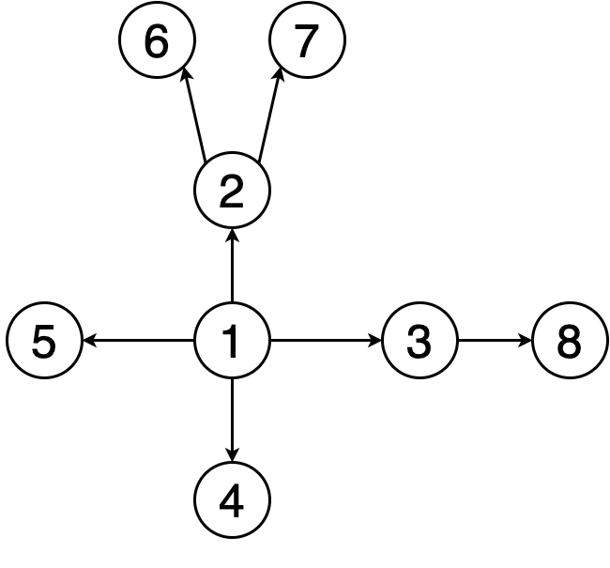
GRAPH
Graphs are another fundamental data structure in computer science and mathematics that are used to represent and model various real-world relationships and networks.
A graph is composed of two main components: vertices (or nodes) and edges.
Directed vs. Undirected Graphs: In a directed graph, edges have a direction, meaning they go from one vertex to another. In an undirected graph, edges have no direction, and they simply connect two vertices without any specific order.
Weighted vs. Unweighted Graphs: In a weighted graph, each edge is assigned a numerical value or weight, which can represent various quantities, such as distance, cost, or strength of a relationship. Unweighted graphs, on the other hand, do not assign weights to their edges.
Multigraphs: A multigraph is a graph in which an edge can connect the same two nodes multiple times.

Slide 14
CONCLUSION
In conclusion, I want to give you a quick overview of what we've covered Throughout this journey, you've been introduced to the fundamental concepts of data structures and algorithms. We've explored things like arrays, linked lists, sorting algorithms, and graph traversal – all of which are crucial tools for efficient coding and problem-solving in the world of computer science. However, remember that learning is an ongoing process. Consider this course as a stepping stone in your educational path. Continue your exploration of advanced DSA topics, take on coding challenges, and embark on projects to solidify your understanding. The beauty of mastering DSA is that it opens doors to exciting opportunities in the field. Employers value these skills, and they can be a game-changer in your career. So, as you complete this course, pat yourself on the back for the progress you've made. But remember, learning is continuous. Keep exploring, keep practicing, and keep honing your skills. Your coding journey is bound to be both rewarding and fulfilling!"

Slide 15


